Slide 1
Module - 4
Quantum Mechanics
Kamalakanta Satpathy

Slide 2
Outlines:
Brief History
State of a System (Wave Function)
Probability Interpretation
Properties of a wave function
Expectation values

Slide 3
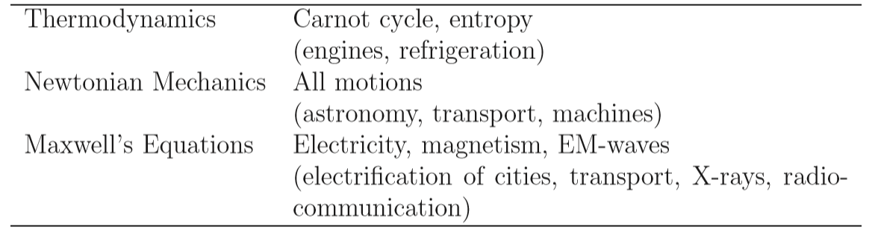
A Brief History
Major physics theories, successful by the end of the 19th century.
However, one of the most innocuous seeming of the unexplained phenomena was to change the course of scientiﬁc history i.e., black body radiation

Slide 4
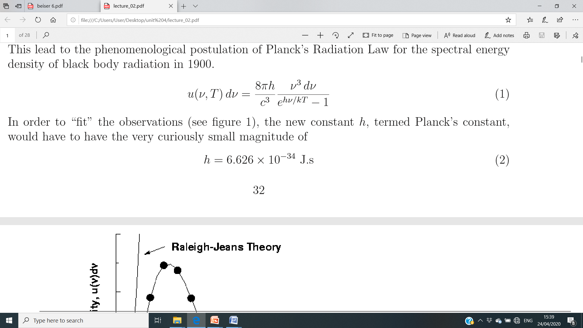
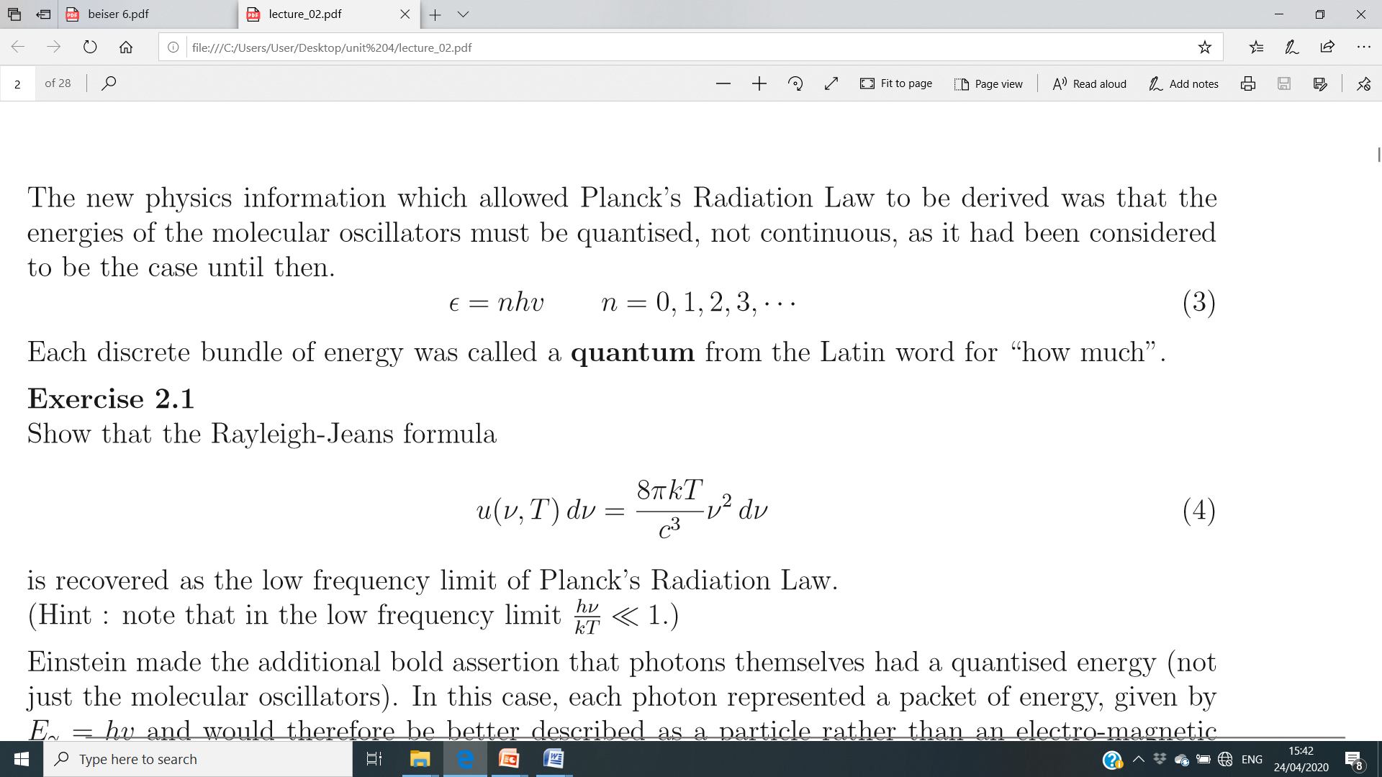
The failure of classical mechanics lead to the phenomenological postulation of Planck’s Radiation Law for the spectral energy density of black body radiation in 1900;
The new physics information which allowed Planck’s Radiation Law to be derived was that the energies of the molecular oscillators must be quantised, not continuous;

Slide 5
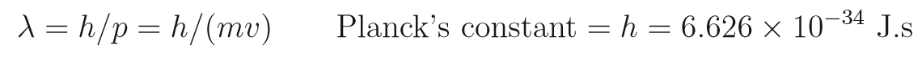
Einstein made the additional bold assertion that photons themselves had a quantised energy . Each photon represented a packet of energy, given by
E = hν and would therefore be better described as a particle rather than an electro-magnetic wave. These particles of light were called photons.
The Photo-electric eﬀect, Compton Eﬀect and Pair Production could all be well described by considering the photon (particle) theory of light rather than the wave theory of light.
de Broglie proposed that particles might also display wave-like properties. He postulated the de Broglie relation, connecting the wave and particle properties together via Planck’s constant and identiﬁes the de Broglie “wavelength” associated with a particle.

Slide 6
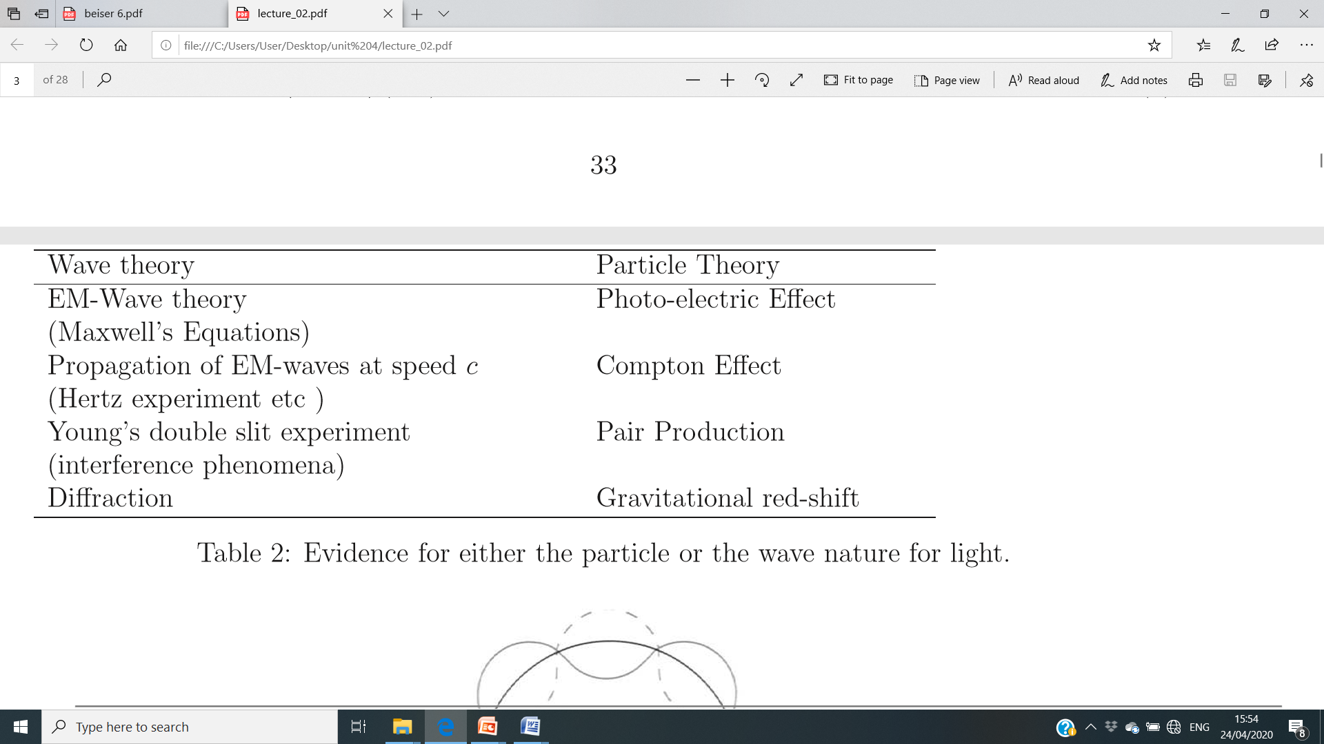
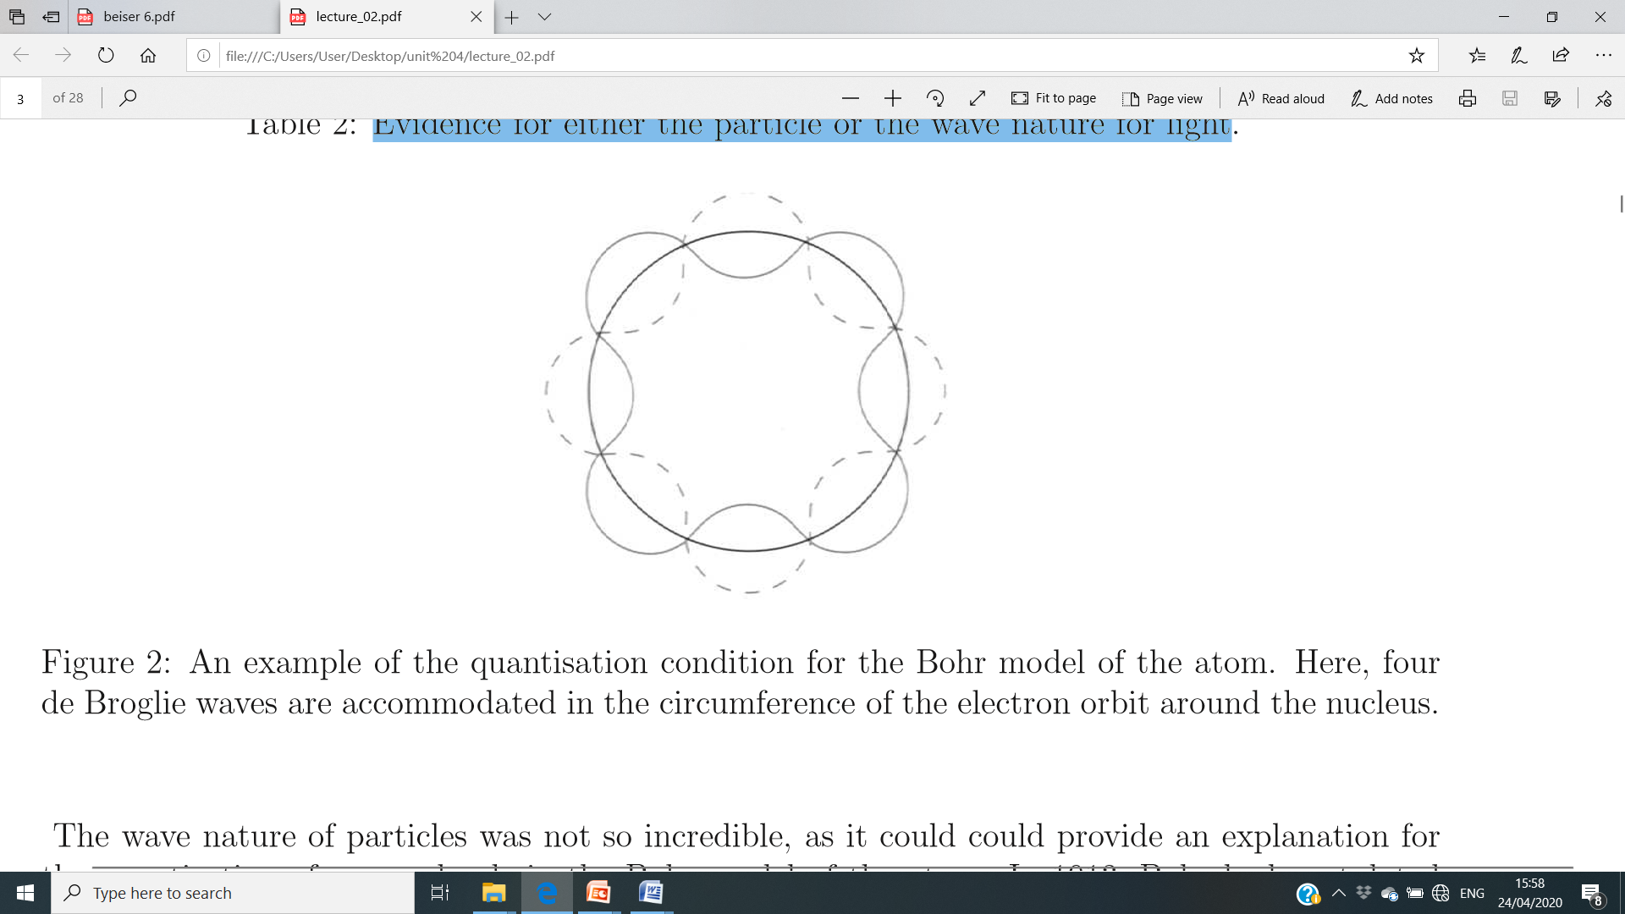
Evidence for either the particle or the wave nature for light
Bohr quantisation condition. Here, four de Broglie waves are accommodated in the circumference of the electron orbit around the nucleus.

Slide 7
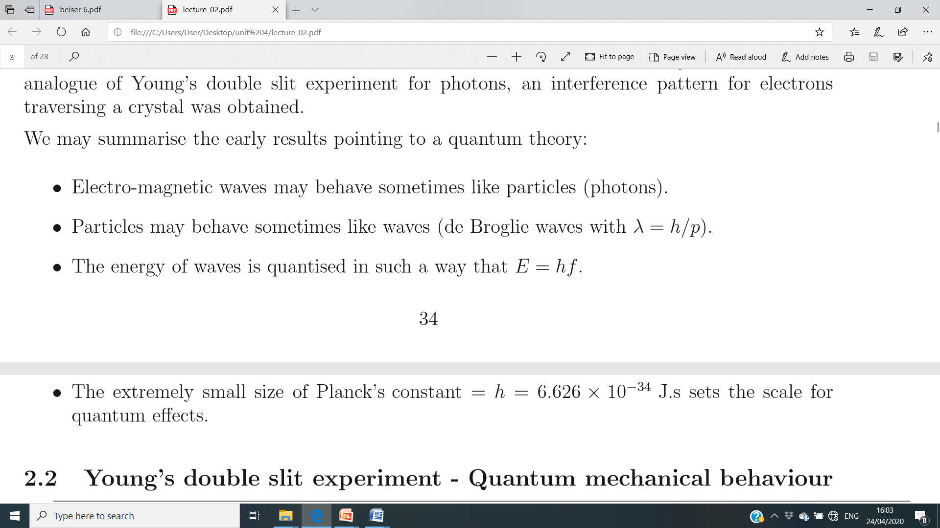
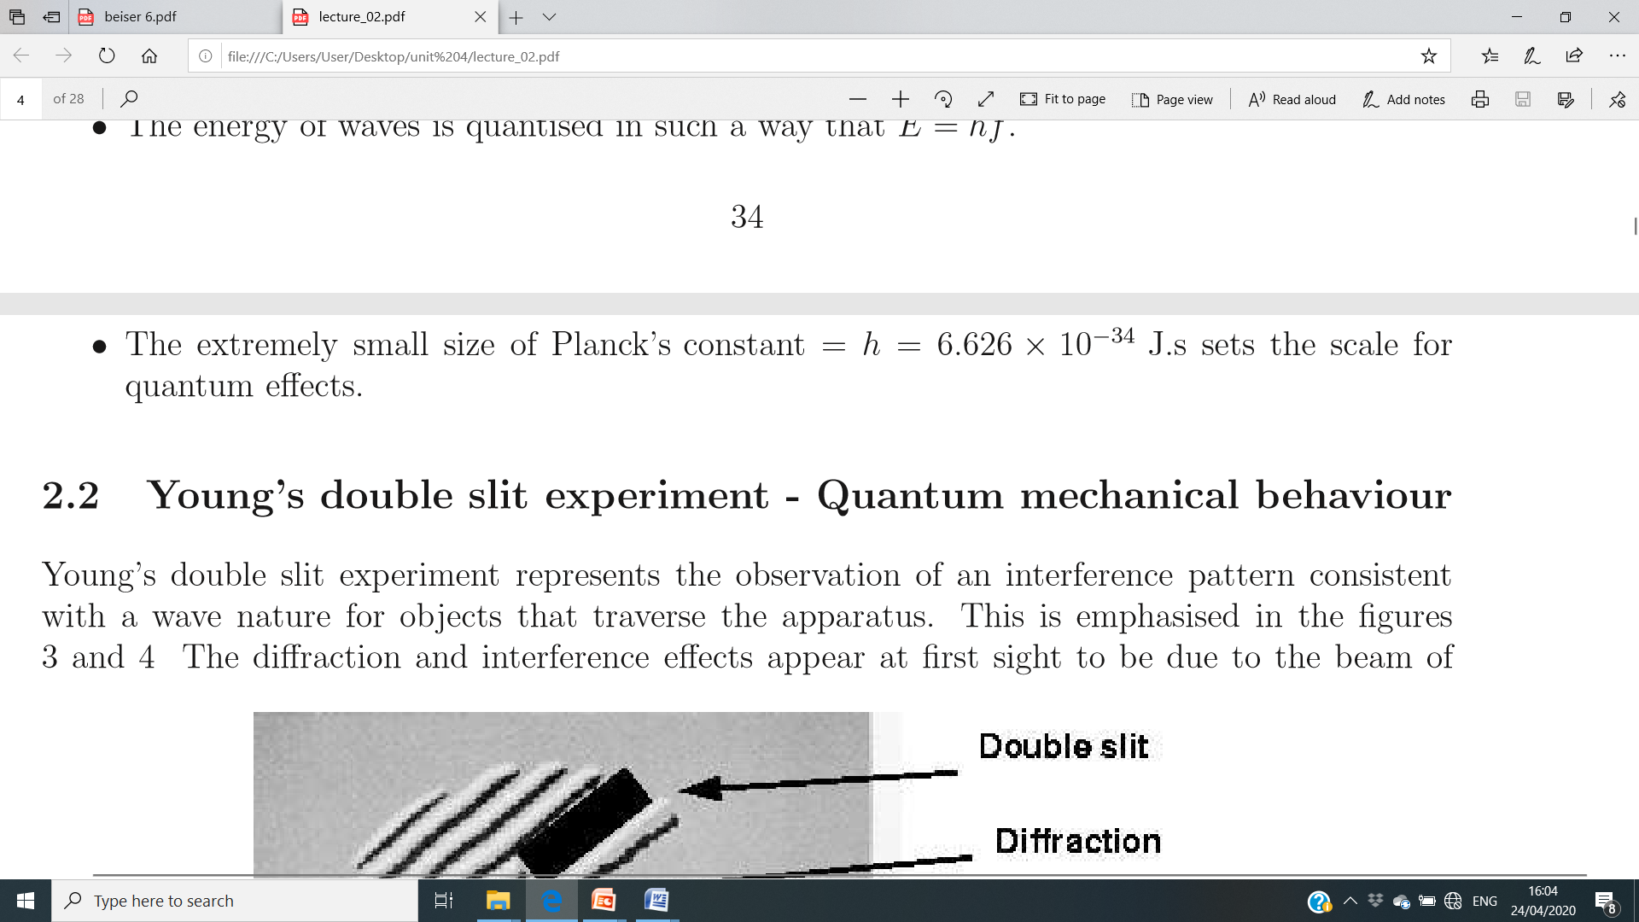
We may summarise the early results pointing to a quantum theory:

Slide 8
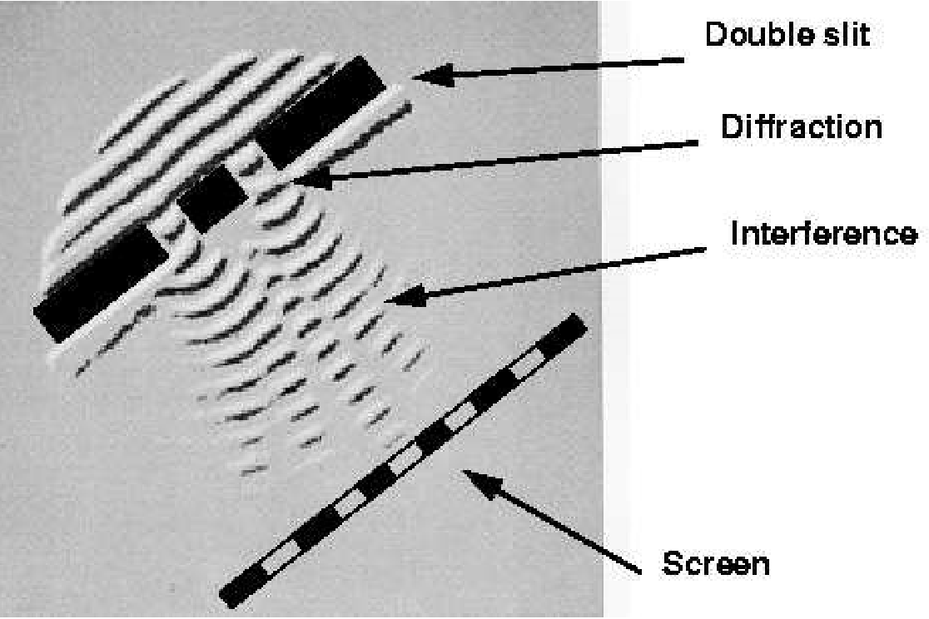
Young’s double slit experiment - Quantum mechanical behaviour
Young’s double slit experiment with water waves

Slide 9
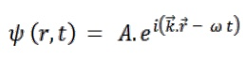
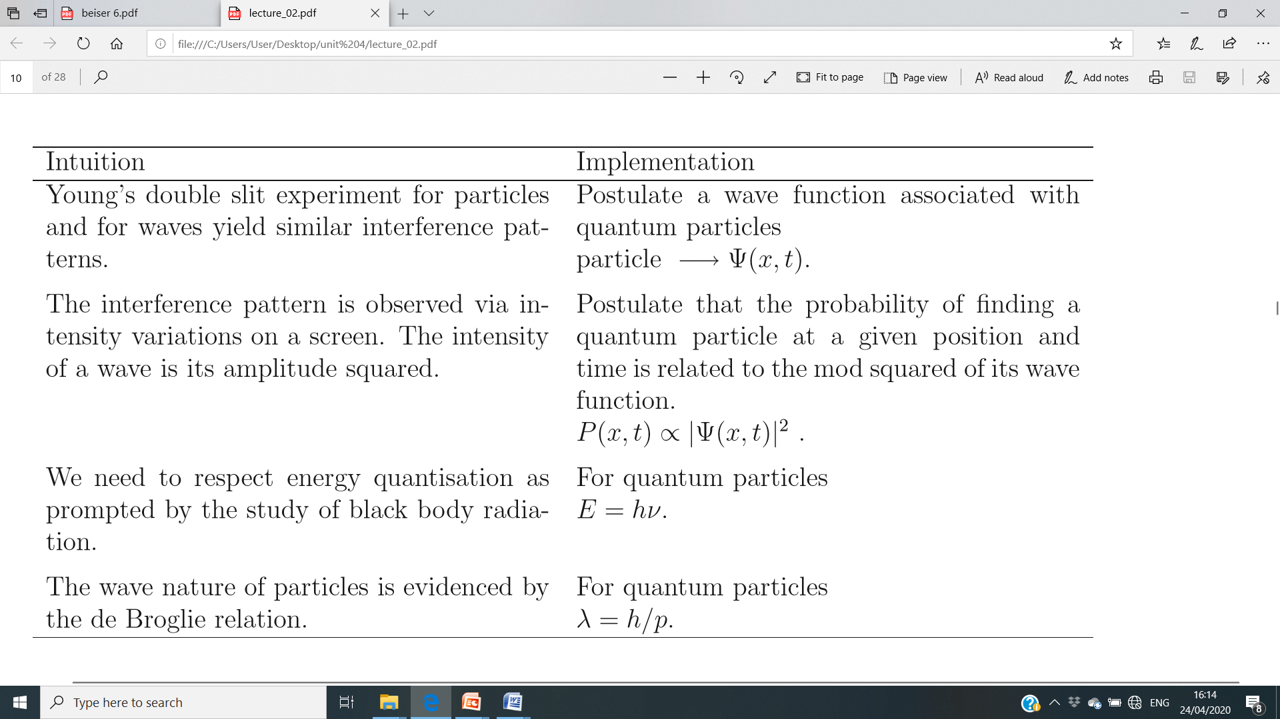
Considering the analogies between Young’s double slit experiment performed with water waves, electro-magnetic waves and with electrons, we can now specify some properties for a new theory of mechanics, termed wave mechanics and is generally expressed as;

Slide 10
Quantum Mechanics
Describes the dynamics of Matter at the microscopic level and is the only valid framework for describing the microphysical world.
Founding basis of all modern physics phenomena.

Slide 11
In General:
In classical(CM)/Newtonian mechanics, the future history of a particle is completely determined by its initial position and momentum together with the forces that act upon it.
Quantum Mechanics (QM) relates with the observable quantities (position, momentum etc..). The kind of certainty about the future characteristic is impossible because the initial state of a particle cannot be established with sufficient accuracy.
Classical mechanics is an approximation of quantum mechanics.

Slide 12
The quantity whose relationship with quantum mechanics is probabilities.
for ex., the radius of the electron’s orbit in a ground state hydrogen atom is always exactly 5.3×10⁻¹¹ m, as the Bohr theory does.
QM states that this is the most probable radius as in most experiment trials will yield a different value, either larger or smaller, but the value most likely to be 5.3×10⁻¹¹ m.

Slide 13
State of a System:
Wave Function (the quantity with which quantum mechanics is concerned is the wave function Ψ of a particle).
Ψ itself has no physical interpretation. The square of its absolute magnitude evaluated at a particular place at a particular time is proportional to the probability of finding the body there at that time.
Wave functions are usually complex with both real and imaginary parts. A probability, however, must be a positive real quantity.

Slide 14
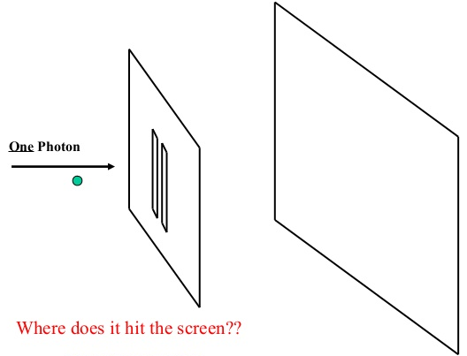
Strange World of QM:

Slide 15
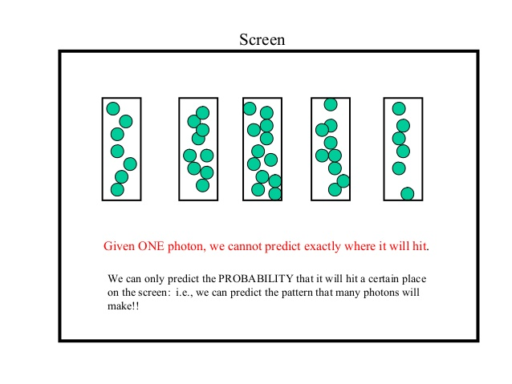
screen
Given one photon/particle, we can’t predict exactly where it will hit.
We can only predict the Probabilty that it will hit a certain place
on the screen: i.e., we can predict the pattern that many photons will make.
That’s why Einstein famously quoted,
@ God doesn’t play dice with the Universe.

Slide 16
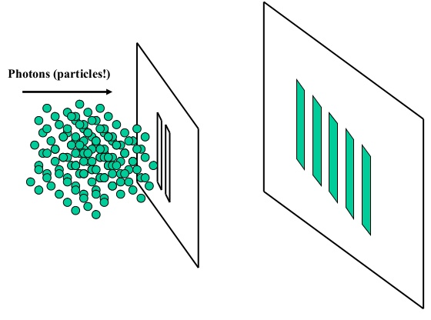
The pattern we observed can be predicted through the application of QM.
Erwin Schrödinger came up with an equation that predicts the ‘Probabilty wave’ Ψ (psi).
This mathematical term (psi) is used to predict all kinds of physical phenomena
at the atomic level – from interference pattern to light emitted from atom.

Slide 17
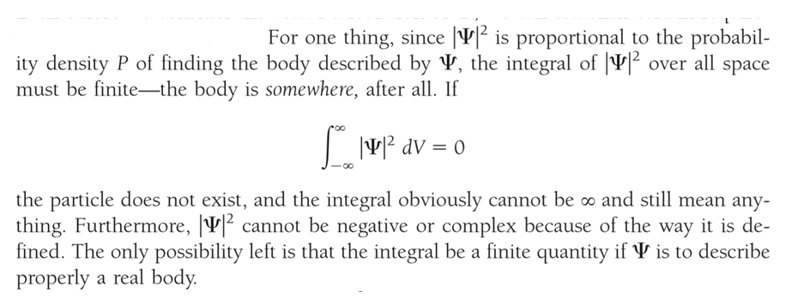
Normalization:

Slide 18
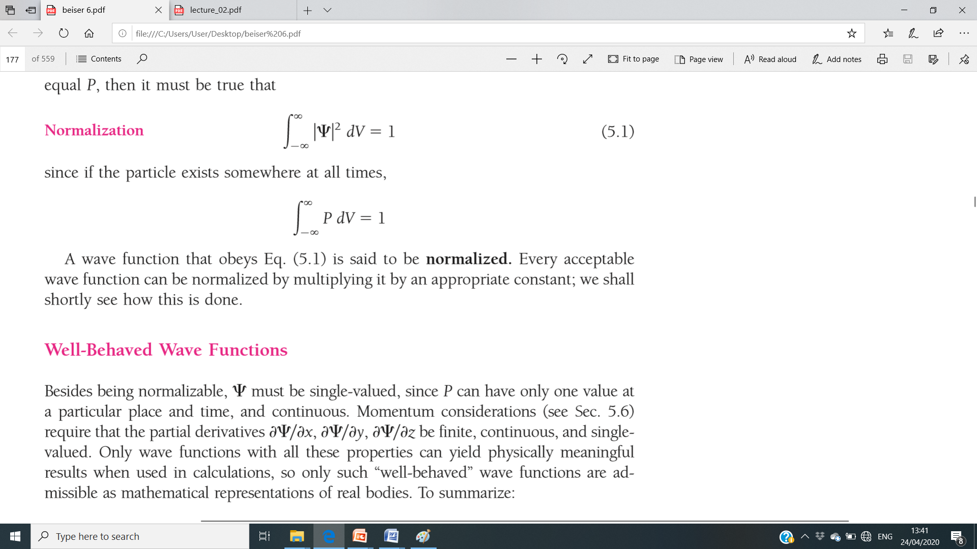

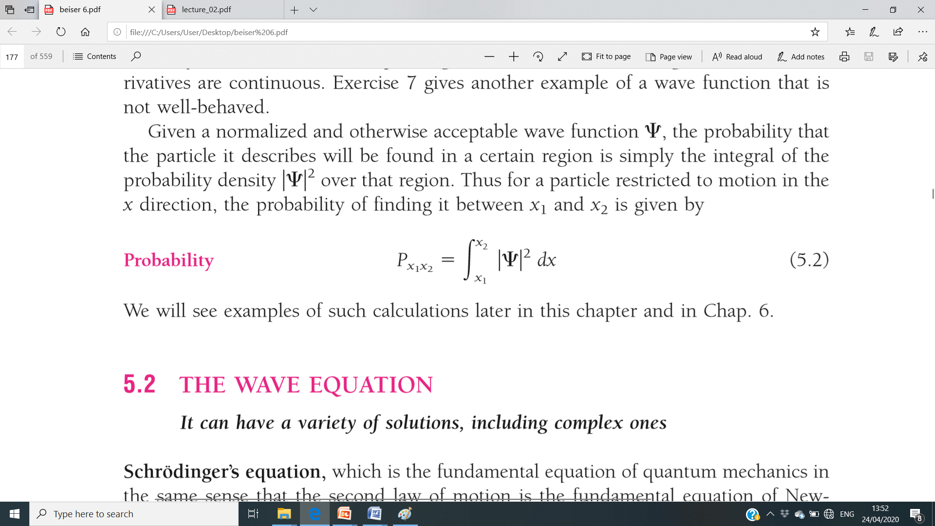
The only possibility is;
A wave function that obeys the equation is said to be normalized.
Or,
where P is the probability density
Thus for a particle restricted to motion in the x direction, the probability of finding it between x₁ and x₂ is given by;

Slide 19
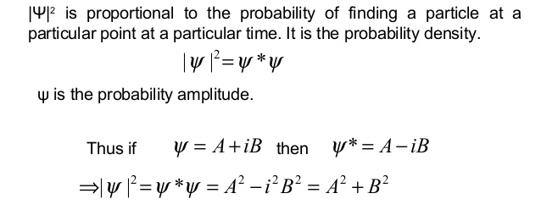
Probability Density:
is always a positive real quantity

Slide 20
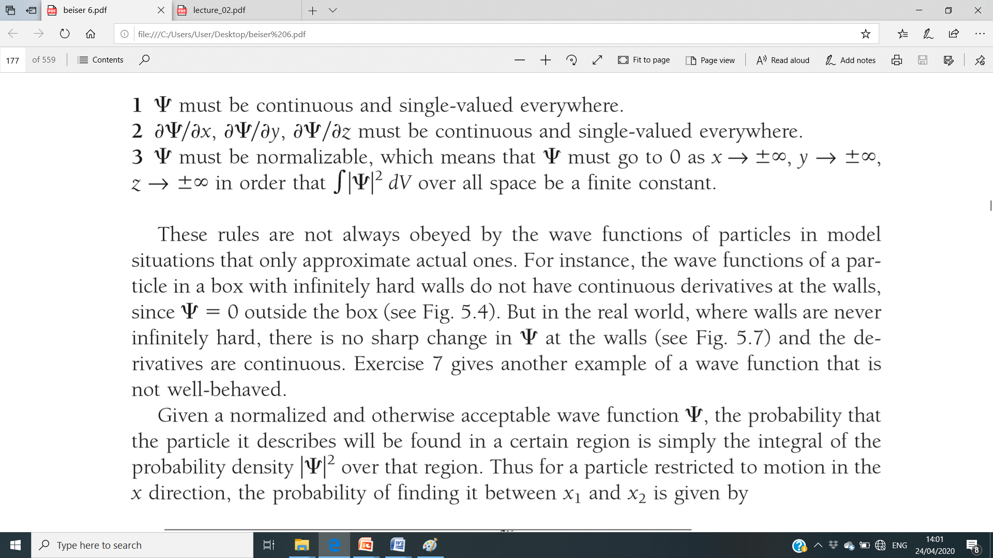
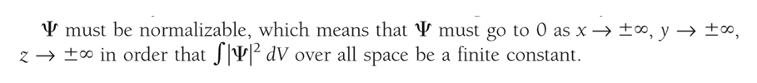
Properties:
1.
Single Valued: If Ψ has more than one value at any point, it mean more than
one value of probability of finding the particle at that point which is ridiculous.
Finite: If Ψ is infinite, it means an infinite large probability of finding the particles
at that point which would violates the Uncertainty principle.
2.
3.
If Ψ satisfies all the above properties, then it is termed as a well behaved wave function.

Slide 21
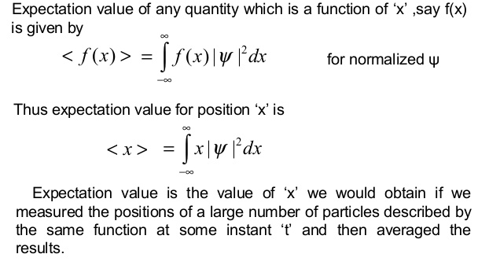
Expectation Values
How to extract information from a wave function: Once the wave equation is solved for a particle in a given physical situation, the resulting wave function Ψ(x, y, z, t) contains all the information about the particle that is permitted by the uncertainty principle.

Slide 22
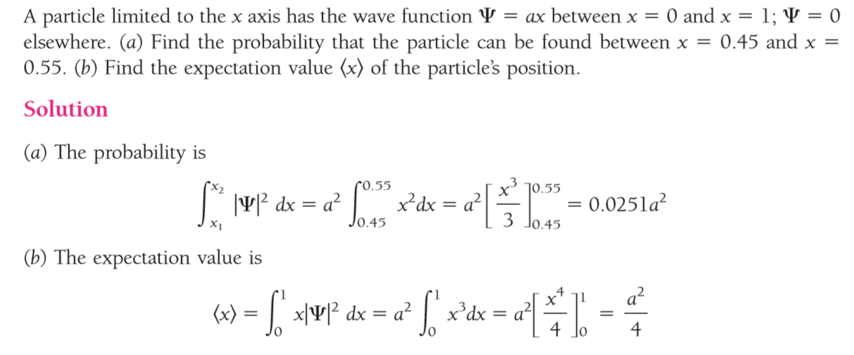
Question:

Slide 23
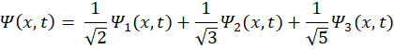
Q. Given
Find the probability of finding the particle in the state
Ans.: The probability is
Since, we are interested in the state 1, hence probability ~
Applying the normalisation condition, we will have the probability in the state ‘1’ will be 1/2.

Slide 24
To be Cont....

